Slide 1

Parallel and Distributed Cloud Computing
Notes:
1
Cloud Computing Quotes from Vivek Kundra (Federal CIO):
"The cloud will do for government what the Internet did in the '90s," he said. "We're interested in consumer technology for the enterprise," Kundra added. "It's a fundamental change to the way our government operates by moving to the cloud. Rather than owning the infrastructure, we can save millions."
http://www.nextgov.com/nextgov/ng_20081126_1117.php
“I believe it's the future," he says. "It's moving technology leaders away from just owning assets, deploying assets and maintaining assets to fundamentally changing the way services are delivered.“
http://www.cio.de/news/cio_worldnews/867008
"It's definitely not hype," says Vivek Kundra, CTO for the District of Columbia government, which plans to blend IT services provided from its own data center with external cloud platforms like Google Apps. "Any technology leader who thinks it's hype is coming at it from the same place where technology leaders said the Internet is hype.“
http://www.cio.de/news/cio_worldnews/867008/

Slide 2
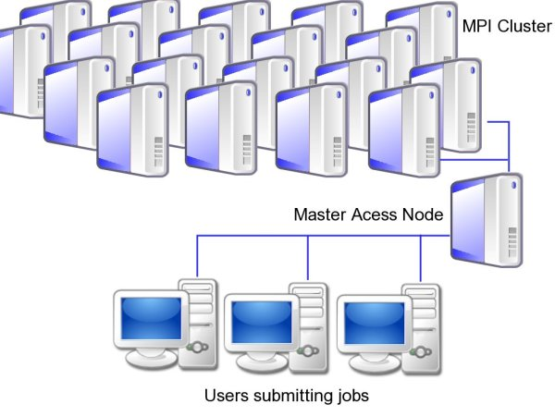
Classification of Distributed Computing Systems
These can be classified into 4 groups: clusters, peer-to-peer networks, grids, and clouds.
A computing cluster consists of interconnected stand-alone computers which work cooperatively as a single integrated computing resource. The network of compute nodes are connected by LAN/SAN and are typically homogeneous with distributed control running Unix/Linux. They are suited to HPC.

Slide 3
Peer-to-peer (P2P) Networks
In a P2P network, every node (peer) acts as both a client and server. Peers act autonomously to join or leave the network. No central coordination or central database is needed. No peer machine has a global view of the entire P2P system. The system is self-organizing with distributed control.
Unlike the cluster or grid, a P2P network does not use dedicated interconnection network.
P2P Networks are classified into different groups:
Distributed File Sharing: content distribution of MP3 music, video, etc. E.g. Gnutella, Napster, BitTorrent.
Collaboration P2P networks: Skype chatting, instant messaging, gaming etc.
Distributed P2P computing: specific application computing such as SETI@home provides 25 Tflops of distributed computing power over 3 million Internet host machines.
Notes:
The clusters within a grid can be owned by diverse organizations.

Slide 4
Computational and Data Grids
Grids are heterogeneous clusters interconnected by high-speed networks. They have centralized control, are server-oriented with authenticated security. They are suited to distributed supercomputing. E.g. TeraGrid.
Like an electric utility power grid, a computing grid offers an infrastructure that couples computers, software/middleware, people, and sensors together.
The grid is constructed across LANs, WANs, or Internet backbones at a regional, national, or global scale.
The computers used in a grid include servers, clusters, and supercomputers. PCs, laptops, and mobile devices can be used to access a grid system.
Notes:
The clusters within a grid can be owned by diverse organizations (Vos), located in different geographic zones and be diverse.

Slide 5
Clouds
A Cloud is a pool of virtualized computer resources. A cloud can host a variety of different workloads, including batch-style backend jobs and interactive and user-facing applications.
Workloads can be deployed and scaled out quickly through rapid provisioning of VMs. Virtualization of server resources has enabled cost effectiveness and allowed cloud systems to leverage low costs to benefit both users and providers.
Cloud system should be able to monitor resource usage in real time to enable rebalancing of allocations when needed.
Cloud computing applies a virtualized platform with elastic resources on demand by provisioning hardware, software, and data sets dynamically. Desktop computing is moved to a service-oriented platform using server clusters and huge databases at datacenters.
Notes:
The cloud is owned and operated typically by one organization; is homogeneous; and uses virtualization.

Slide 6
Software Environments for Distributed Systems and Clouds: Service-Oriented Architecture (SOA) Layered Architecture
In web services, Java RMI, and CORBA, an entity is, respectively, a service, a Java remote object, and a CORBA object. These build on the TCP/IP network stack. On top of the network stack we have a base software environment, which would be .NET/Apache Axis for web services, the JVM for Java, and the ORB network for CORBA. On top of this base environment, a higher level environment with features specific to the distributed computing environment is built.
Loose coupling and support of heterogeneous implementations make services more attractive than distributed objects.
CORBA Stack | RMI Stack | Web Services Stack
IDL | Java interface | WSDL
CORBA Services | RMI Registry | UDDI
CORBA Stubs/Skeletons | RMI Stubs/Skeletons | SOAP Message
CDR binary encoding | Java native encoding - serialization | XML Unicode encoding
IIOP | JRMP | HTTP
RPC or Message Oriented Middleware (Websphere MQ or JMS)
ORB | JVM | .NET/Apache Axis
TCP/IP/DataLink/Physical
Notes:
CDR: Common Data Representation
JRMP: Java Remote Method Protocol
Universal Description, Discovery and Integration (UDDI) is a directory service where businesses can register and search for Web services.

Slide 7
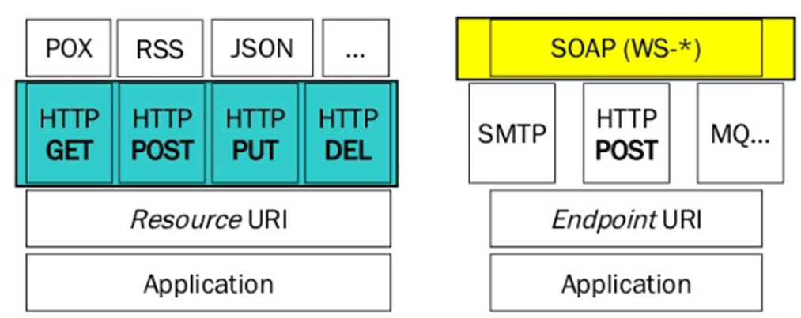
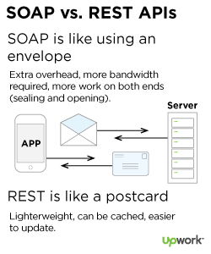
Service-Oriented Architecture (SOA) Layered Architecture: SOAP vs REST services
REST supports many data formats, whereas SOAP only allows XML.
REST supports JSON (smaller data formats and offers faster parsing compared to XML parsing in SOAP which is slower).
REST provides superior performance, particularly through caching for information that’s not altered and not dynamic.
REST is used most often for major services such as Amazon, Twittter.
REST is generally faster and uses less bandwidth.
SOAP provides robust security through WS-Security and so useful for enterprise apps such as banking and financial apps; REST only has SSL.
SOAP offers built-in retry logic to compensate for failed communications.
Notes:
Simple Object Access Protocol (SOAP) and Representational State Transfer (REST)
Universal Description, Discovery and Integration (UDDI) is a directory service where businesses can register and search for Web services.

Slide 8
Performance Metrics and Scalability Analysis
Performance Metrics:
CPU speed: MHz or GHz, SPEC benchmarks like SPECINT
Network Bandwidth: Mbps or Gbps
System throughput: MIPS, TFlops (tera floating-point operations per second), TPS (transactions per second), IOPS (IO operations per second)
Other metrics: Response time, network latency, system availability
Scalability:
Scalability is the ability of a system to handle growing amount of work in a capable/efficient manner or its ability to be enlarged to accommodate that growth.
For example, it can refer to the capability of a system to increase total throughput under an increased load when resources (typically hardware) are added.

Slide 9
Scalability
Scale Vertically
To scale vertically (or scale up) means to add resources to a single node in a system, typically involving the addition of CPUs or memory to a single computer.
Tradeoffs
There are tradeoffs between the two models.
Larger numbers of computers means increased management complexity, as well as a more complex programming model and issues such as throughput and latency between nodes.
Also, some applications do not lend themselves to a distributed computing model.
In the past, the price difference between the two models has favored "scale up" computing for those applications that fit its paradigm, but recent advances in virtualization technology have blurred that advantage, since deploying a new virtual system/server over a hypervisor is almost always less expensive than actually buying and installing a real one.

Slide 10
Scalability
One form of scalability for parallel and distributed systems is:
Size Scalability
This refers to achieving higher performance or more functionality by increasing the machine size. Size in this case refers to adding processors, cache, memory, storage, or I/O channels.
Scale Horizontally and Vertically
Methods of adding more resources for a particular application fall into two broad categories:
Scale Horizontally
To scale horizontally (or scale out) means to add more nodes to a system, such as adding a new computer to a distributed software application. An example might be scaling out from one Web server system to three.
The scale-out model has created an increased demand for shared data storage with very high I/O performance, especially where processing of large amounts of data is required.

Slide 11
Amdahl’s Law
It is typically cheaper to add a new node to a system in order to achieve improved performance than to perform performance tuning to improve the capacity that each node can handle. But this approach can have diminishing returns as indicated by Amdahl’s Law.
Consider the execution of a given program on a uniprocessor workstation with a total execution time of T minutes. Now, let’s say that the program has been parallelized or partitioned for parallel execution on a cluster of many processing nodes.
Assume that a fraction α of the code must be executed sequentially, called the sequential block. Therefore, (1 - α ) of the code can be compiled for parallel execution by n processors. The total execution time of program is calculated by:
α T + (1 - α ) T / n
where the first term is the sequential execution time on a single processor and the second term is the parallel execution time on n processing nodes.
All system or communication overhead is ignored here. The I/O and exception handling time is also not included in the speedup analysis.

Slide 12
Amdahl’s Law
Amdahl’s Law states that the Speedup Factor of using the n-processor system over the use of a single processor is expressed by
Speedup = S = T / [α T + (1 - α ) T / n]
= 1 / [α + (1 - α ) / n]
The maximum speedup of n is achievable only when α = 0, i.e. the entire program is parallelizable.
As the cluster becomes sufficiently large, i.e. n → ∞, then S → 1 / α, an upper bound on the speedup S. This upper bound is independent of the cluster size, n. The sequential bottleneck is the portion of the code that cannot be parallelized.
Example, α = 0.25 and so (1 – 0.25) = 0.75 then the maximum speedup, S = 4 even if one uses hundreds of processors.
Amdahl’s Law teaches us that we should make the sequential bottleneck as small as possible. Increasing the cluster size alone may not result in a good speedup in this case.

Slide 13
Amdahl’s Law
Example: suppose 70% of a program can be speed up if parallelized and run on multiple CPUs instead of one CPU.
N = 4 processors
S = 1 / [0.3 + (1 – 0.3) / 4] = 2.105
Doubling the number of processors to N = 8 processors
S = 1 / [0.3 + (1 – 0.3) / 8] = 2.581
Double the processing power has only improved the speedup by roughly one-fifth. Therefore, throwing in more hardware is not necessarily the optimal approach.

Slide 14
System Efficiency
To execute a fixed workload on n processors, parallel processing may lead to a system efficiency defined as:
System Efficiency, E = S / n = 1 / [α n + (1 - α ) ]
System efficiency can be rather low if the cluster size is very large.
Example: To execute a program on a cluster with n = 4, α = 0.25 and so
(1 – 0.25) = 0.75,
E = 1 / [0.25 * 4 + 0.75] = 0.57 or 57%
Now if we have 256 nodes (i.e. n = 256)
E = 1 / [0.25 * 256 + 0.75] = 0.015 or 1.5%
This is because only a few processors (4, as in the previous case) are kept busy, while the majority of the processors (or nodes) are left idling.

Slide 15
Fault Tolerance and System Availability
High availability (HA) is desired in all clusters, grids, P2P networks, and cloud systems. A system is highly available if it has a long Mean Time to Failure (MTTF) and a short Mean Time to Repair (MTTR).
System Availability = MTTF / (MTTF + MTTR)
All hardware, software, and network components may fail. Single points of failure that bring down the entire system must be avoided when designing distributed systems.
High-availability is, ultimately, the holy grail of the cloud. For clouds, availability relates to the time that the datacenter is accessible or delivers the intended IT service as a proportion of the duration for which the service is purchased.

Slide 16
Computing Availability
CASE 1
Consider that a cloud instance (such as an EC2 instance) over a 6 week timeline has a total uptime of 900 hours and a total downtime of 108 hours with 6 failures in this timeline. Compute the availability.
Total timeline in hours = 6 weeks * 7 days/week * 24 hours/day = 1008 hours
MTTF = 900 / 6 = 150
MTTR = 108 / 6 = 18
Availability = 150 / (150 + 18) = (150 / 168) = 0.892 or 89.2%
CASE 2
Same as Case 1 but we have 2 failures instead. Compute availability.
MTTF = 900 / 2 = 450
MTTR = 108 / 2 = 54
Availability = 450 / (450 + 54) = (450 / 504) = 0.892 or 89.2%

Slide 17
Reliability vs. Availability
Reliability is a measure of the probability that an item will perform its intended function without failures for a specified interval under stated conditions.
Higher the MTTF, higher the reliability.
A commonly used measure of reliability:
Failure Rate (λ) = number of failures / total time
Calculate the Failure Rate for Case 1 and Case 2.
Case 1 had a MTTF of 150 and a failure rate = 6 failures / 1008 = 0.00595
Case 2 had a MTTF of 450 and a failure rate = 2 failures / 1008 = 0.00198
Even though both cases had the same Availability, case 2 has a better reliability because it has a better MTTF and a lower failure rate.

Slide 18
Reliability vs. Availability
A piece of equipment can be available but not reliable. For example, a machine is down 6 minutes every hour. This translates into an availability of 90% (i.e. 54 minutes / 60 minutes = 0.9) but a reliability of less than 1 hour.
Generally speaking a reliable machine has high availability but an available machine may or may not be very reliable.
Something to think about:
If you are flying do you want the aircraft to have high levels of availability or reliability? Think about it. If the aircraft has poor availability, then this may have an influence on whether the plane departs (and therefore lands) on time. On the other hand, if the aircraft has poor reliability, then this may have an influence on whether the plane lands at all!

Slide 19
Interpreting Cloud Availability
Cloud vendors use slang like three 9’s, four 9’s, or five 9’s when talking about the availability of their datacenter or cloud services.
E.g. 99.9% availability is referred to as three 9’s and is an uptime of greater than 99.9%. This corresponds to a downtime per year of 8 hours and 45 minutes per year. This is calculated as:
(365 × 24) – 0.999 (365 × 24) = 8760 - 8751.24 = 8.76 hours = 8 hours and 45 minutes. This is a downtime of more than 1 working day and can have real financial consequences for the enterprise cloud user.
Calculate the downtime per year given an availability of four 9’s (i.e. an uptime of 99.99%).
This is calculated as:
(365 × 24) – 0.9999 (365 × 24) = 8760 – 8759.124 = 0.876 hours = 52 minutes and 30 secs

Slide 20
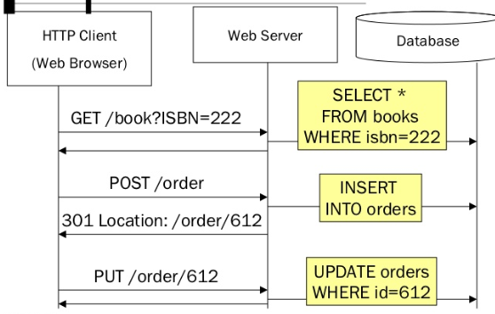
RESTful Web Service Example

Slide 21
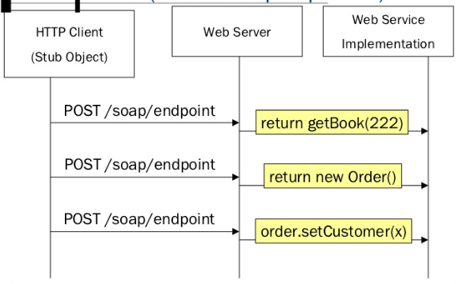
SOAP Web Service Example

